Slide 1
The Industrial Revolution

Slide 2
Warm Up April 1
In which country did the Industrial Revolution begin?
Spain
France
United States
England

Slide 3
Beginnings of the Industrial Revolution
Industrial Revolution - Increased output of machine-made goods
Began in England in 1700s
Had resources to support it (water power and coal, iron ore, rivers, harbors)
Had all 3 factors of production:
Land
Labor
Capital (wealth)
Spread to Europe and North America
People wove textiles by hand before the I.R.

Slide 4
Beginnings of the Industrial Revolution
Agricultural Revolution helped jumpstart the Industrial Revolution
Wealthy landowners bought more land, called enclosures (b/c they put fences around them.)
Experimented with more productive methods, which led to crop rotation: rotated crops to restore nutrients to the soil.

Slide 5
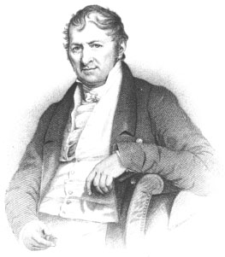
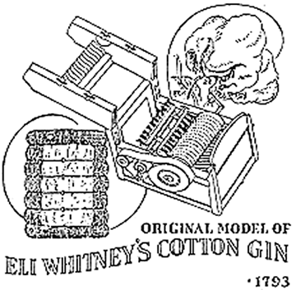
Important Inventions
Cotton Gin by Eli Whitney
Separated raw cotton from the seeds
American cotton production went from 1.5 million pounds to 85 million pounds

Slide 6
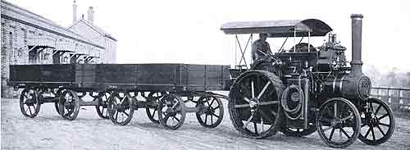
Important Inventions
Steam Engine by James Watt
Invented a much more efficient engine with help of entrepreneur (Boulton); organizes, manages, and takes on the risks of business
Led to steam boats and steam powered locomotives (trains)

Slide 7
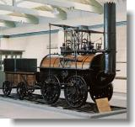
Important Inventions
Railroad
Spurred industrial growth
Created hundreds of thousands of new jobs
Boosted agricultural and fishing industries (could now transport their products far away)
Encouraged people to take distant city jobs

Slide 8
Impacts of Industrialization
Widened the wealth gap between industrialized and non-industrialized countries
But it strengthened their ties meaning:
--industrialized countries needed raw materials for their factories to run (from less developed places)
--saw the non-industrialized countries as markets to sell their products
--leads to imperialism--one country’s rule over another land

Slide 9
Impacts of Industrialization
Transformed Society
Gave Europe tremendous economic power
Population, health, and wealth eventually rose, despite harsh working conditions
Development of a middle class created better education and democratic participation

