Slide 1
The Russian Revolution

Slide 2
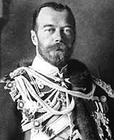
Pre-Revolutionary Russia
Only true autocracy left in Europe
No type of representative political institutions
Nicholas II became Tsar in 1884
Believed he was the absolute ruler anointed by God
Revolution broke out in 1905
--Russo-Japanese War (1904)

Slide 3
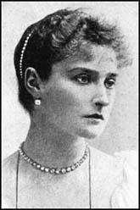
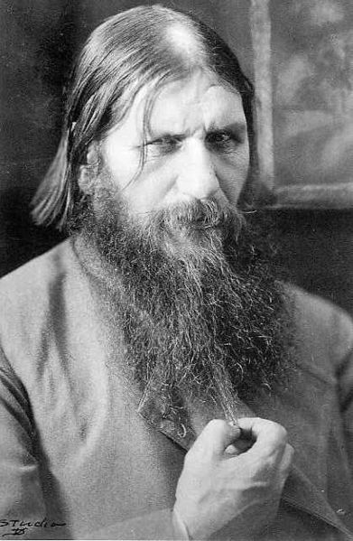
Alexandra
She came under the influence of a believed holy man Rasputin
She made all important decisions while Nicholas was away
Even more blindly committed to autocracy than her husband
Origins of Rasputin’s power
Scandals surrounding Rasputin served to discredit the monarchy

Slide 4
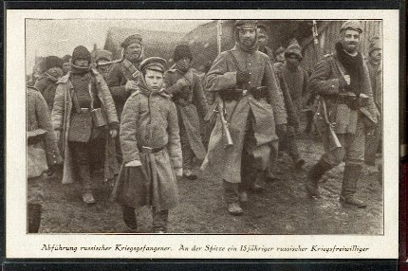
World War I: “The Last Straw”
War revealed the ineptitude and arrogance of the country’s aristocratic elite
The Russian “Steam Roller”
Corrupt military leadership and contempt for ordinary Russian people
Average peasant has very little invested in the War
Poorly supplied troops
Result: Chaos and Disintegration of the Russian Army

Slide 5
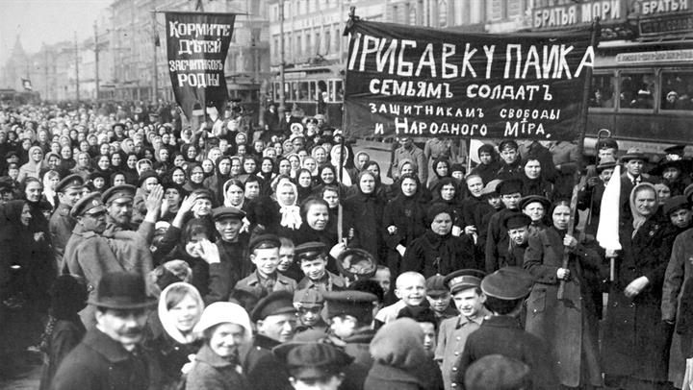
The March Revolution
Began over bread prices.
Escalates into a full strike within days
Duma – Legislative Assembly – meets and establishes a provisional government
Tsar abdicated on March 17th

Slide 6
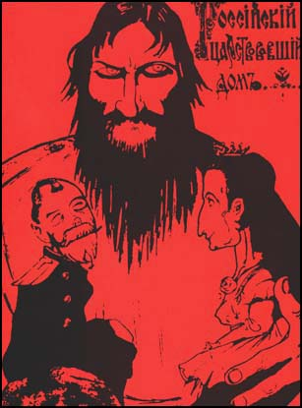
The Collapse of the Imperial Government
Nicholas leaves for the Front—September, 1915
Alexandra and Rasputin throw the government into chaos
The new government’s decision to stay in WWI was a major blunder.

Slide 7
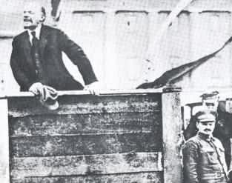
The Two Revolutions of 1917
The March Revolution (March 12)
The November Revolution (November 6) – is led by the Bolsheviks and Vladimir Lenin
The Bolsheviks were dedicated to a violent revolution

Slide 8
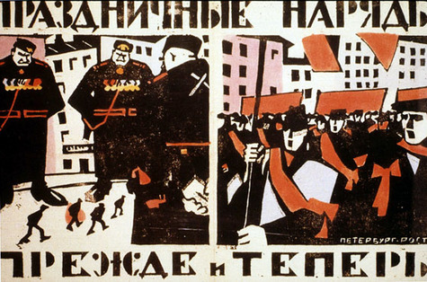
Soviet Political Ideology
More radical and revolutionary than the Provisional Government
Most influenced by Marxist socialism
Emulated western socialism
Two Factions
-- “Mensheviks”
-- “Bolsheviks”

Slide 9
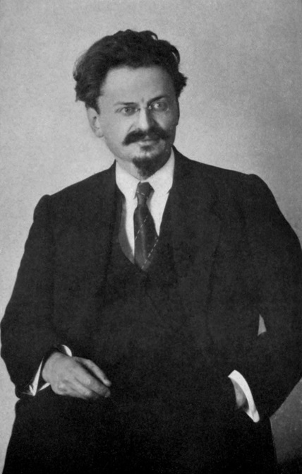
Triumph of the Communist
Leon Trotsky – organized the well disciplined Communist Army
Russian Civil war ensued – Reds v. Whites
The Reds (Communist) ultimately win and take control of the government.

Slide 10
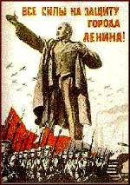
Lenin Steps into This Vacuum
Amnesty granted to all political prisoners in March of 1917
Lenin’s arrival in Petrograd
A tremendously charismatic personality
“Peace, Land, Bread”
“All Power to the Soviets”
Bolshevik party membership exploded
Consolidation of Bolshevik power

