Slide 1
Causes of World War I
Imperialism - France and England had many colonies
- Germany industrialized, in the late 1800s & wanted began competing with France, Britain for colonies
Nationalism - devotion to interests & culture of one’s nation (pride)
- Nationalism led to competition, antagonism between nations
- Many feared Germany’s growing power in Europe
- Various ethnic groups resented domination & wanted independence (Slavs in Serbia)
- Russia saw itself as protector of all Slavic peoples

Slide 2
Causes of World War I
Militarism - The belief that a nation should have a large and powerful military
- Cost of building & defending empires led to more military spending
- By 1890, Germany had strongest army on European continent
- Competed with Britain for sea power
- Led other powers to join naval arms race

Slide 3
Causes of World War I
Alliance System -
- Promised to fight if the alliance was attacked
- Small conflict could turn into a large war
- Triple Entente or Allies - France, Britain, Russia
- Germany, Austria-Hungary,& Italy were called the Triple Alliance

Slide 4
An Assassination Leads to War
Balkan Peninsula was known as “the powder keg of Europe” because:
- Ethnic rivalries among Balkan peoples
- Leading powers had economic & political interests (Russian port & German railroad)

Slide 5
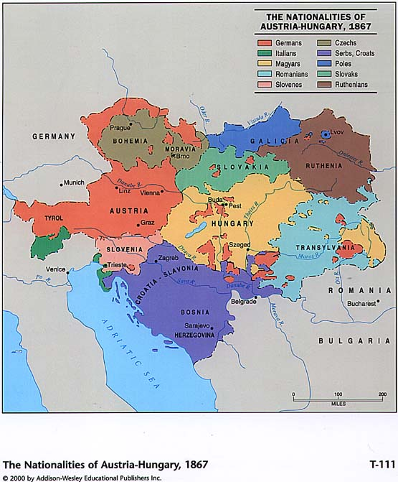

Slide 6
An Assassination Leads to War
June 28, 1914 - Francis Ferdinand, Archduke of Austria-Hungary and heir to the throne assassinated in Sarajevo
Austria-Hungary declared war on Serbia
- Expected short war
Within 2 months the world was at war
- Alliance system pulled one nation after another into war

Slide 7
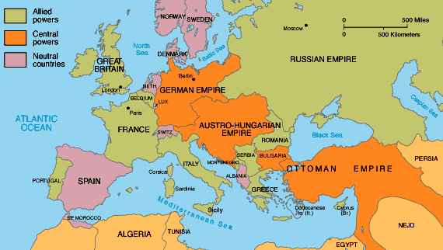
War Breaks out in Europe
Archduke's assassination was spark needed to start war
Austria-Hungary blamed Serbia
July 28, 1914 Austria Hungary declared war on Serbia

Slide 8
War Breaks out in Europe
Russia prepared to defend Serbia (both countries were Slavic)
Germany declared war on Russia (allies with Austria-Hungary)
- Germany also declared war on Russia's ally France

Slide 9
War Breaks out in Europe
Germany marched through Belgium to invade France
- England declared war on Germany (had promised to protect Belgium)
Europe divided into two opposing groups.
- Central Powers - Austria-Hungary, Germany, the Ottoman Empire, and Bulgaria
- Allied Powers - Serbia, Russia, France, Great Britain, Japan, Italy, and 15 smaller nations

Slide 11
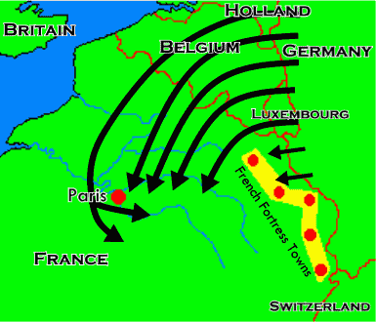
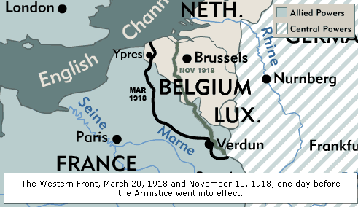
The Fighting Starts
Germany’s Schlieffen Plan: hold Russia, defeat France quickly & then Russia
German troops swept through Belgium & cause major refugee crisis
Schlieffen Plan failed at the Battle of the Marne

Slide 12
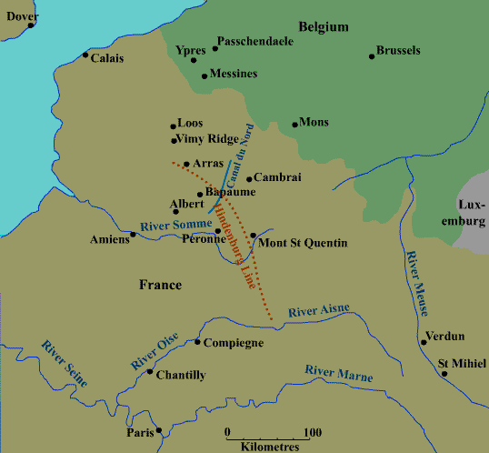
Fighting the War
Most of the fighting against Germany occurred on the western front in France and Belgium
By spring 1915, 2 parallel systems of trenches crossed France

Slide 13
Fighting the War
Men lived in trenches amidst filth, pests, polluted water, poison gas, dead bodies
- Constant bombardment, battle fatigue produce “shell shock”
- Physical problems include dysentery, trench foot, & trench mouth
- Many died of diseases
- Area between the trenches known as “no mans land"
Armies fought to gain only yards of ground in bloody trench warfare

Slide 14
Battle of Verdun
Lasted from Feb. – Dec. 1915
Bloodiest battle of the War
Over 700,000 people were killed
Changes the way wars are fought

Slide 15
Fighting the War
War became a stalemate - neither side was able to win a decisive victory
Technology caused massive casualties in the war
- Machine guns
- Tanks
- Mustard gas
- Airplanes used for the 1st time in war

Slide 16
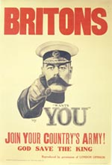
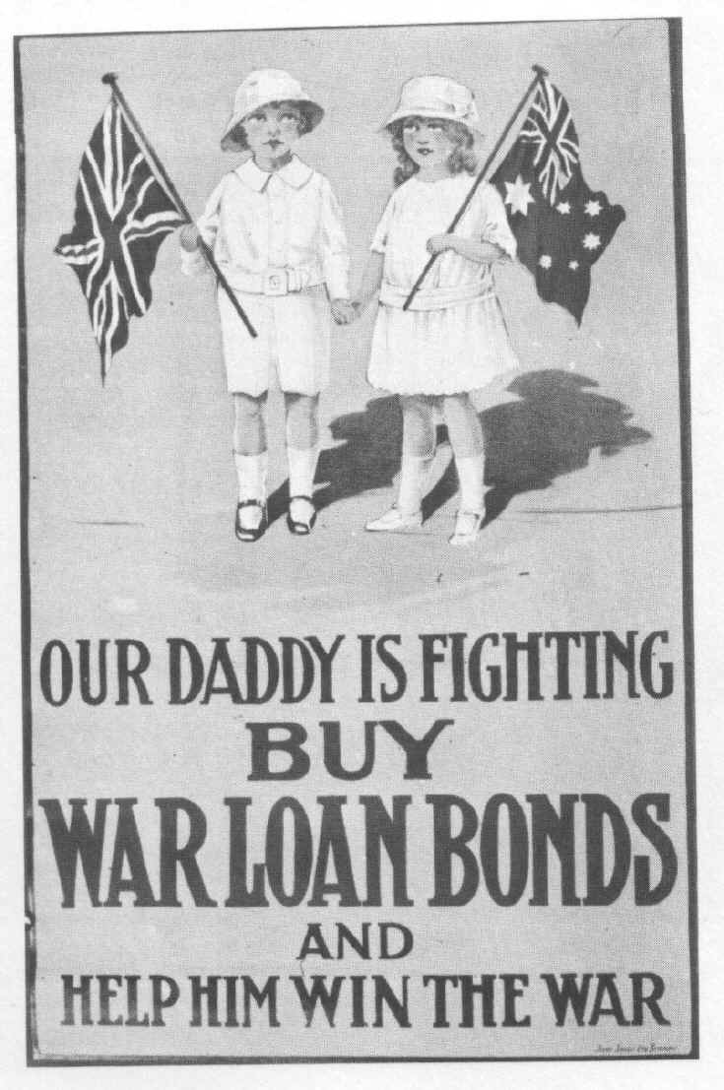
Home Front
World War I was a total war
- Required civilians to be as committed to victory as soldiers
- Factories made weapons
- Farmers grew food for soldiers
- Governments used propaganda to motivate citizens to work harder
People patriotic at 1st
- Many people lost heart after the war dragged on

Slide 17
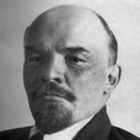
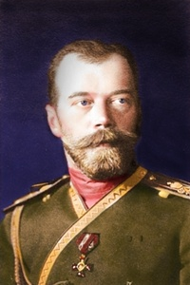
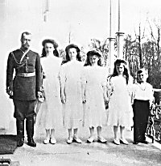
Russian Revolution
Russian czar was a poor military leader
Russia lacked the food and weapons to fight Germany
People began wanting out of the war
Vladimir Lenin seized power in Russia
- Communism - where the government has complete control over the economy and people's lives
Lennon got Russia out of the war
- March 1918 - Treaty of Brest-Litovsk gave Germany a large area of the former Russian Empire

Slide 18
America Stays Neutral
Most Americans wanted to stay out of the war
- Socialists, pacifists, & many ordinary people were against U.S. in war
Naturalized citizens concerned about effect on country of birth
- Germans & Irish
Many people felt ties to British ancestry, language, democracy, & legal system

Slide 19
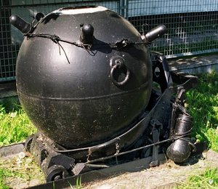
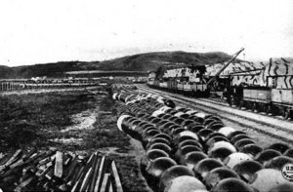
The War Hits the U.S
U.S. sold goods to both sides
- legal as long as ships weren't carrying war supplies
European countries started trying to stop all U.S. ships
- Trying to cut off supplies to enemy U.S. protested
- The British blockaded & mined North Sea, stop war supplies reaching Germany
- also stop food, fertilizer
- U. S. merchant ships seldom reached Germany
- Germany had difficulty importing food & fertilizer
- 1917, famine caused 750,000 Germans to starve to death

Slide 20
The War Hits the U.S.
Germany began using new invention to stop ships (U-boat)
- set up U-boat counter-blockade of Britain
May 17, 1915 – German u-boat sank passenger ship (Lusitania)
- 128 Americans among the dead
- U.S. public opinion turned against Germany
- U.S. outraged that Germany sank an unarmed passenger ship

Slide 21
The War Hits the U.S.
Germany promised not to sink any more passenger ships
- Less than 1 year later Germany torpedoed a French Steamer
- President Wilson convinced congress to build more ships and increase the size of the army
- Germany promised not to sink anymore passenger or merchant ships (2nd time)
President Wilson protests again & Germany asked U.S. to get Britain to end food blockade
- otherwise would renew unrestricted submarine war

Slide 22
America enters the war
Wilson tried to mediate
- Called for “a peace between equals”
- “ a peace without victory” where neither side would impose harsh terms on the other
Kaiser announced U-boats would sink all ships in British waters
Zimmerman telegram
- Told Mexico that Germany would help it get back all the land it lost in the Mexican war if it helped them
- Outraged Americans
Germany sank two more American Ships
April 16, 1917 - U.S.A. entered World War I

Slide 23
American Troops Go on the Offensive
1917 - Russia pulled out of war
Germans shifted armies to western front
- Came within 50 miles of Paris
Americans helped stop German advance & turn tide against Central Powers

Slide 24
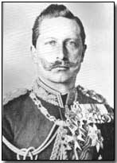
The Collapse of Germany
November 3, 1918, Austria-Hungary surrendered to Allies
German sailors, & soldiers rebelled
Socialists established German republic
- Kaiser abdicated the throne
Germans were exhausted
November 11, 1918 armistice, or truce, signed
- Known as "Veterans Day"

Slide 25
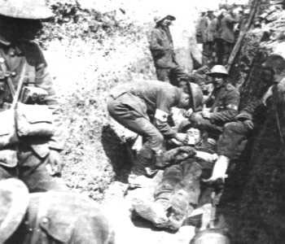
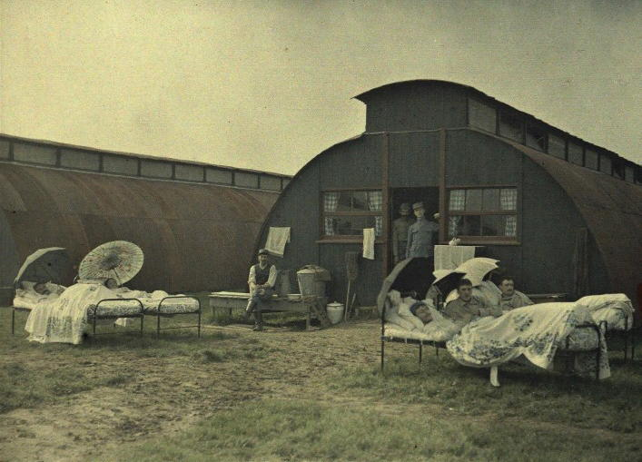
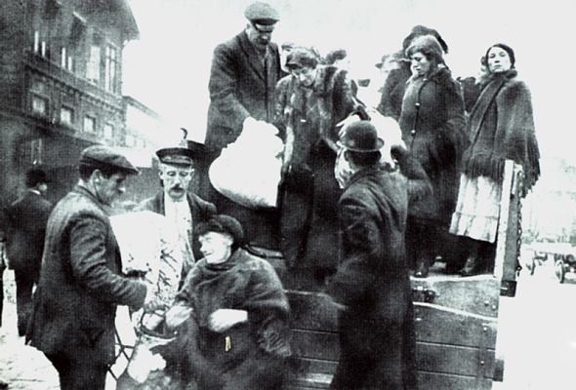
The Final Toll
World War I bloodiest war in history to date
Over half of 22 million dead were civilians
20 million more were wounded
10 million people became refugees

Slide 26
Planning For Peace
President Wilson issued a plan for peace (Fourteen Points)
Fourteen Points
- Called for smaller militaries
- End of secret treaties
- Freedom of the seas
- Next 8 points dealt with political boundaries
14th Point Called for the creation of a League of Nations
- League of Nations - an international organization that would settle disputes and keep peace
- Wilson felt that the 14th was the most important

Slide 27
Planning For Peace
President Wilson went to peace conference in Europe after war
- 1st time a president had left the country while in office
France and England demanded that Germany pay reparations
- Money that a defeated nation pays to make up for a war’s destruction
- France also wanted to prevent further German invasions
Italian Vittorio Orlando wanted Austrian-held territory
Conference excluded Central Powers, Russia, & small Allied nations

Slide 28
Treaty of Versailles
Treaty of Versailles - formally ended the war
Changed the map of Europe
- Ottoman Empire and Austria- Hungary Empire were gone
- New countries formed (Yugoslavia and Czechoslovakia)
Placed various conditions on Germany:
- Couldn’t have an army
- Alsace-Lorraine returned to France

Slide 29
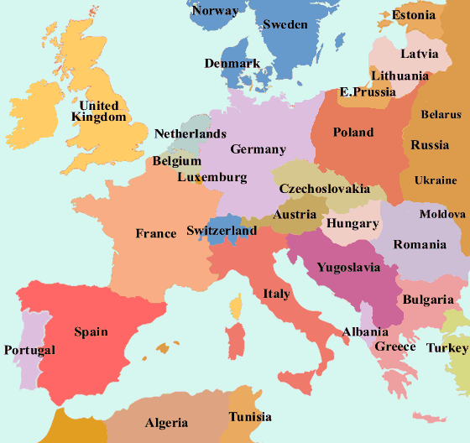
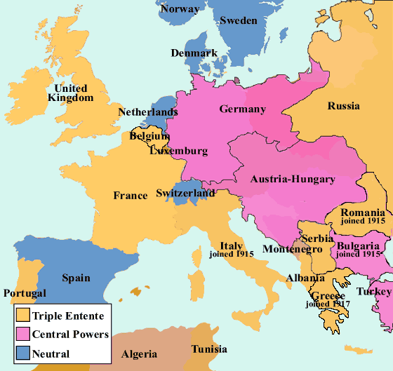

Slide 30
Treaty of Versailles
Germany was forced to pay reparations,
Germany couldn’t pay $33 billion in reparations that Allies want
War-guilt clause - Germany had to accept sole responsibility for war
Russia lost more land than Germany although it had fought with Allies for 3 years
Colonized people’s claims for self-determination ignored
Wilson convinced Europe to form the League of Nations
- Wilson had to give up most of his points in return for League of Nations

