Slide 1
The Scientific Revolution
1550-1789

Slide 2
Why did the Scientific Revolution come about
Renaissance – Question everything
Reformation – Question the Church
Age of Exploration - the discovery of new lands led people to search for other “new” things
Key people- Galileo, Copernicus, Kepler, Newton

Slide 3
What exactly is a Revolution
A complete overthrow of an established government or institution.
A complete change.
Scientific Revolution = a complete change (or a new way) of thinking about the natural world.

Slide 4
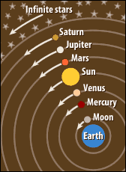
Just one of those thoughts….
Before 1500 people decided what was true or false based on the Bible or Ancient Greek and Roman scholars
Geocentric view of the universe (Aristotle and Ptolemy) - The earth was the center of the universe and everything else moved around it in a completely circular path.
Christianity taught that God placed the earth in the center because it was a special place where life unfolded

Slide 5
A Revolutionary Model
Copernicus - Polish astronomer developed the Heliocentric Theory
The sun is at the center of the universe and everything else moves around it…
On the Revolutions of the Heavenly Bodies- published as he was dying because he knew it would be rejected by scholars and the clergy b/c it contradicted their religious views

Slide 6
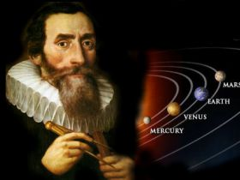
Other Revolutionaries in Science
Kepler - took mathematical data and calculated the elliptical movement of the planets around the sun

Slide 7
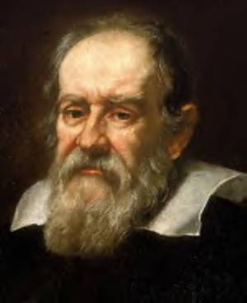
Other Revolutionaries in Science
Galileo - Telescope used to discover many ideas about the universe, Starry Messenger was published describing his observations which conflicted with the church.

Slide 8
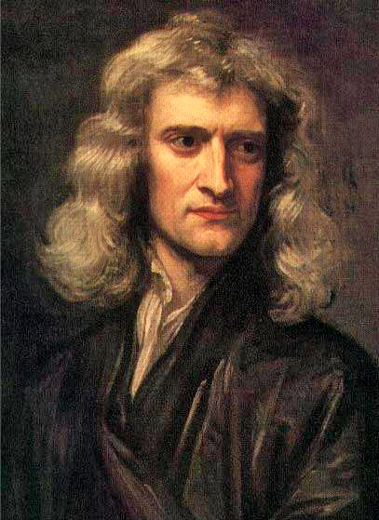
Sir Isaac Newton
Newton defines the three laws of motion
Explained why planets go in elliptical orbits as oppose to straight lines
Universal Law of Gravitation – every object in the universe is attracted to every other object by a force called gravity

Slide 9
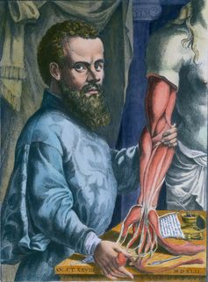
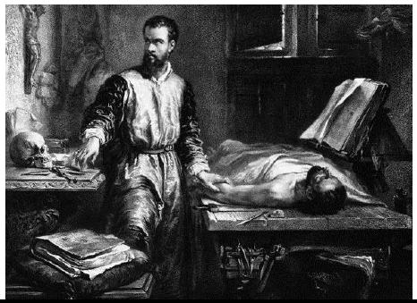
Modern Medicine
The majority of ideas about medicine came from the ancient Greeks
Andreas Vesalius used a “hands on” approach to change some of these ideas
Two kind of blood in the body
Heart was the center of all blood

Slide 10
Rene Descartes
“I think therefore I am”
Asserted that he would only accept those things that his reason said were true
Separation of mind and matter

Slide 11
The Scientific Method
A systematic procedure for collecting and analyzing evidence
Developed by Francis Bacon - he was a philosopher not a scientist

