Slide 1
The Peace Conference of 1919
Or How I Learned to Start Accepting and Hate the Treaty of Versailles

Slide 2
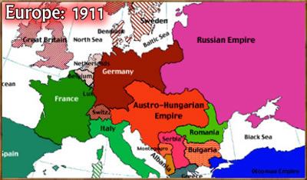
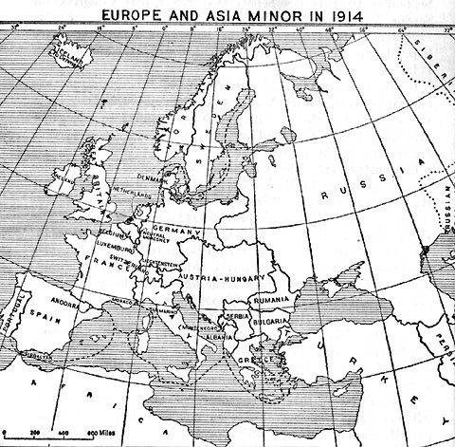

Slide 3
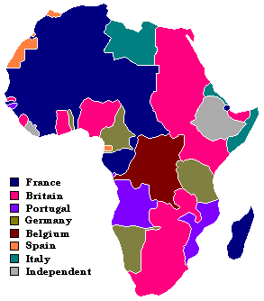

Slide 4
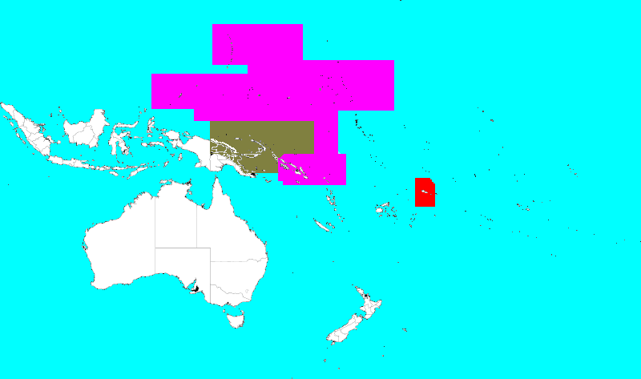

Slide 5
Paris Peace Conference 1919

Slide 6
TREATY OF VERSAILLES: June 28, 1919
GUILT:
Germany took full responsibility for the war
ARMY:
100,000 soldiers,
no heavy artillery,
no airplanes
NAVY:
6 Battleships,
NO submarines
REPARATIONS:
£6.6 M or $33 B

Slide 7
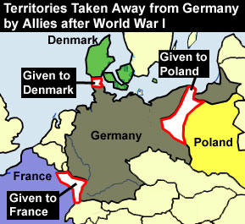
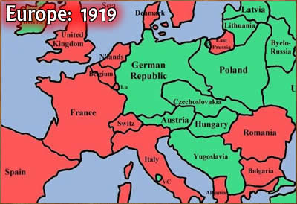
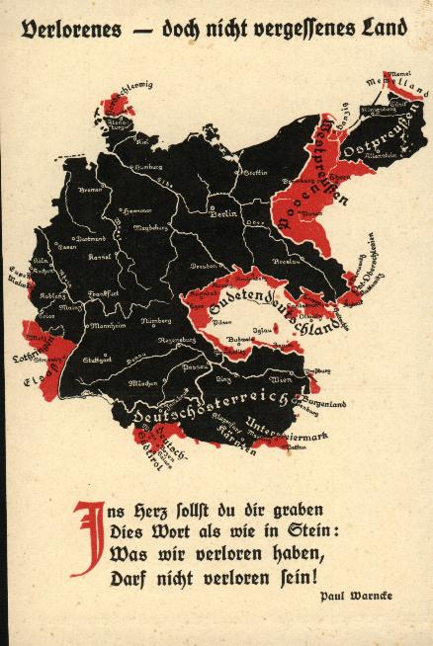
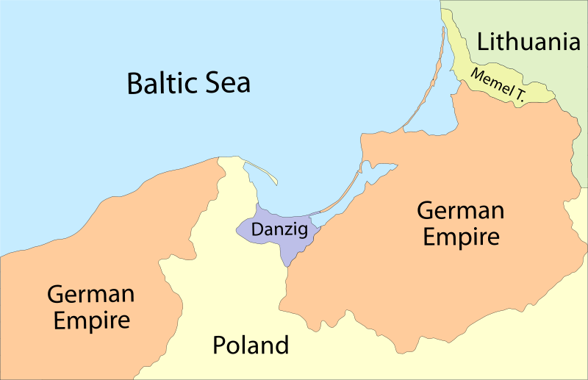

Slide 8
Questions
How did Germany respond to the treaty?
What did the Treaty of Versailles do to Germany?
Who got the best deal out of the treaty and how?
How is the Treaty of Versailles a bridge to World War II?

