Slide 1
The French Revolution

Slide 2
Warm Up April 11
What happened on July 14, 1789 Bastille Day?
Robespierre was executed by guillotine
French women marched all the way to Versailles
A mob stormed a prison looking for ammunition
Napoleon declared himself Emperor of France

Slide 3
The French Revolution
First Estate
1% of the Population
Clergy
Second Estate
2% of the Population
Rich Nobles
Third Estate
97% of the Population
Bourgeoisie – Upper Class
Workers – Middle Class
Peasants – Low Class
Background
France was considered to be the most advanced country in Europe at this time
French society was divided into three classes (called “estates”).

Slide 4
Causes of the French Revolution
The 3rd Estate became disgruntled because they paid the overwhelming majority of the taxes. (Over ½ of their income!)
The 3rd Estate did not support the King Louis XVI or Marie Antoinette.
The 3rd Estate did not like the fact that the Estate-General was controlled exclusively by the 1st and 2nd Estate, and they made the majority of decisions. Each Estate had one vote. So, the 1st and 2nd Estate could outvote the 3rd 2-1
Like the colonists in America, the French looked to the Enlightenment Thinkers as “inspiration.”

Slide 5
The French Revolution Erupts
Activities of the 3rd Estate
Broke away from the Estate – General
Renamed themselves the National Assembly
Made the Tennis Court Oath
Stormed the Bastille
The Bastille was a prison
National Assembly wanted the weapons that were in the Bastille
Became a symbolic event (Called Bastille Day -July 14, 1789, equivalent to the Fourth of July for Americans)

Slide 6
The French Revolution
The National Assembly reformed the country
Adapted a version of the Declaration of Independence, called the Declaration of the Rights of Man – basic liberties for all people.
liberty, property, security, and resistance to oppression
Developed a constitution
Brought about a Legislative Assembly

Slide 7
The French Revolution
Mass hysteria spread across France – called the Great Fear
Peasants marched to the Palace at Versailles and demanded bread
Louis XVI and Marie Antoinette forced from the throne
The Royal Family tried to flee France, but they were caught, held, and eventually executed

Slide 8
Terror Grips France
Reign of Terror (1793-1794)
Maximillian Robespierre rose to power
Used fear to rule France
Sent many to the guillotine
Eventually he was arrested and executed

Slide 9
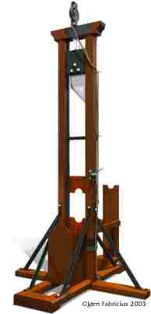
The Guillotine
Developed by Dr. Guillotine
The blade weighed about 88 lbs
Some said that you died too quickly
Not always effective on the first time. Sometimes it was necessary to drop the blade several times in order to sever the head

Slide 10
Dechristianization
The Committee of Public Safety closed all places of worship and created the worship of Reason
Changed the calendar to reflect the revolution
Year 1 start on Sept 22, 1792
12 month calendar – each month had three ten day weeks
Eliminated Sundays and Sunday worship

Slide 11
End of the Reign of Terror
By 1794 the new French Army had pushed its invaders out
People fear Robespierre was becoming to powerful and he was executed on July 28, 1794

Slide 12
New France
In August of 1795 a new Constitution was written to reflect a more stabile gov’t
Two houses for representation
New gov’t was very corrupt
Overthrown by the military led by Napoleon Bonaparte

Slide 13
Warm Up April 13
Which of the following was the time period following the French Revolution characterized by mass executions by the guillotine?
Great Fear
Hundred Days
Waterloo
Reign of Terror

Slide 14
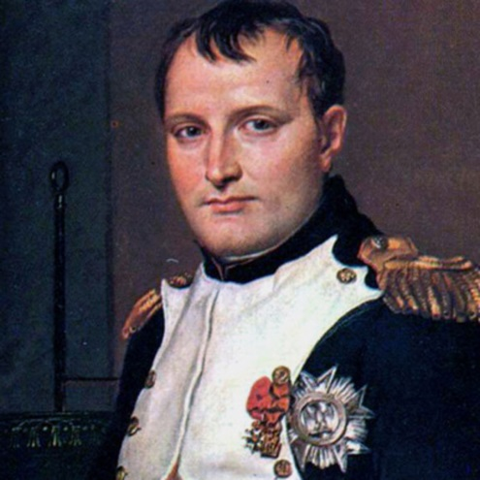
Napoleon’s Background
At the age of 9 Napoleon was sent to military school
At the age of 16 Napoleon became a lieutenant in the French Army
He had several early successful years in the military
Because of the unrest in France during this time the government was very unstable. Napoleon took advantage of this, and with his military fame, Napoleon took political power.
Coup ‘de ‘tat – Sudden take over in power; and overthrow of a government

Slide 15
Napoleon Rules France
Brought stability to France
Leveled taxes across the Estates
Removed dishonest government workers
Restored the church
Aided with public education
Developed the Napoleonic Code
Uniform set of laws
Limited individual liberties
Promoted Napoleon’s power

Slide 16
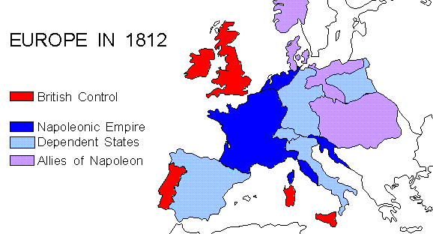
Napoleon Builds an Empire
Sold territory in America (Louisiana Purchase)
Less to worry about
Frustrated England
Financed expansion efforts in Europe
Continued his military prowess, expanded French land throughout Western Europe
Austrian Netherlands
Parts of Italy
Parts of Switzerland

Slide 17
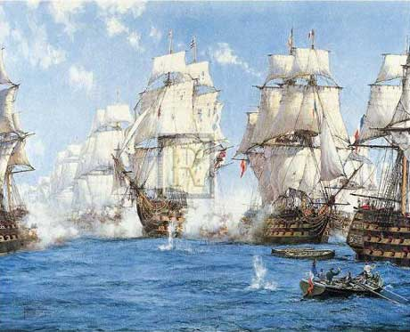
Battle of Trafalgar
Who: France vs. England
What: Napoleon’s only major battle lost
Results
Destroyed French Navy
Solidified England’s power in Europe
Unable to ever conquer England

Slide 18
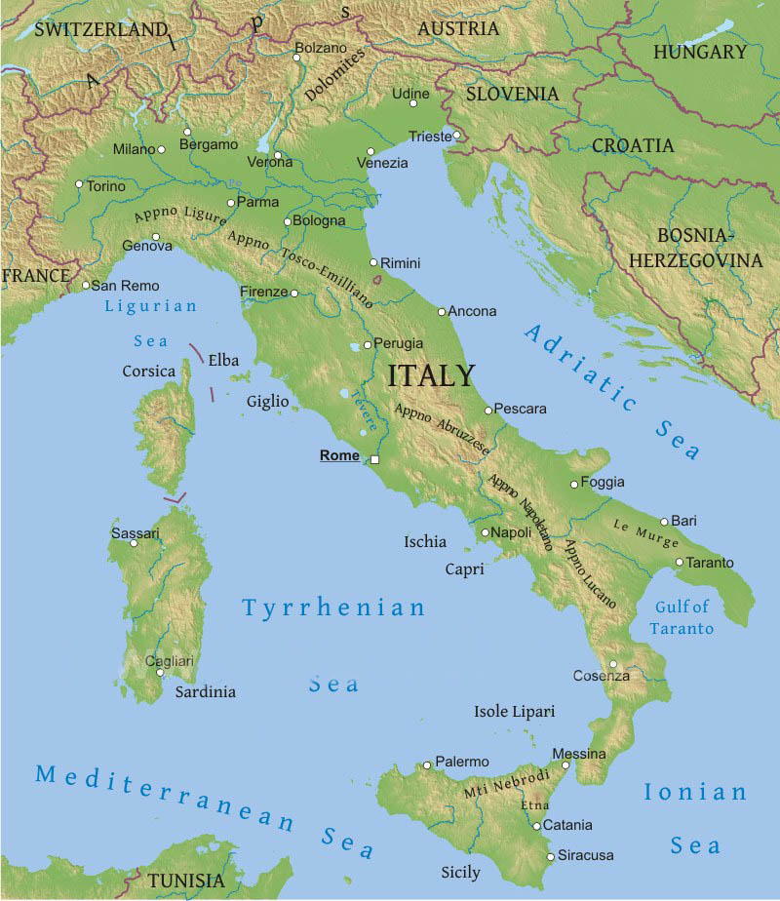
Disaster in Russia
Napoleon tries to invade Russia but is unsuccessful.
Takes 600,000 men in, only 40,000 make it out.
All of Europe rises up to defeat the crippled French Army.
Napoleon is exiled to Elba

Slide 19
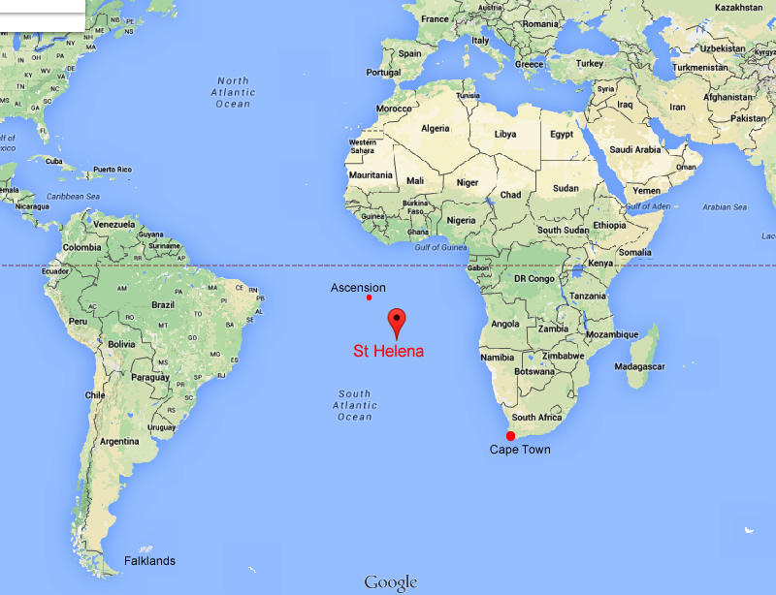
Napoleon’s Later Life
Exiled to Island of Elba
Escaped Elba
Reigned for 100 more days
Napoleons was captured at his final battle at Waterloo
Sent to Island of St. Helena in South Atlantic
Died of stomach problem - 1821 (possibly cancer)

