Slide 1
Warm Up March 28
The heliocentric theory was proposed by
Galileo Galilei
Nicolaus Copernicus
Aristotle
Isaac Newton

Slide 2
The Enlightenment
A new intellectual movement that stressed reason and thought and the power of individuals to solve problems
AKA: The Age of Reason
Sparked by the same fuels as the Reformation and Scientific Revolution
Brought change to Western Civilizations

Slide 3
Philosophes
French for Philosophers- centered in Paris
Key beliefs of all
Reason (truth could be discovered through logical thinking)
Nature (what is natural is good and reasonable)
Happiness (joy and well-being should be sought on earth)
Progress (society and humankind could be improved)
Liberty (call for those won by English in the Glorious Rev. and their Bill of Rights for all)

Slide 4
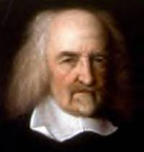
Thomas Hobbes
Key beliefs: without governments to keep order there would be constant war…. Life would be “solitary, poor, nasty, brutish and short.”
To escape this, people had to hand over their rights to a strong ruler- in exchange they gained law and order
AKA: the social contract (an agreement between the people and the government)
Best government = Absolute Monarchy
His Book - Leviathan

Slide 5
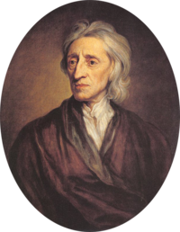
John Locke
Key Beliefs: people can learn from experiences and benefit themselves, are reasonable beings w/ natural ability to govern themselves, and look after the welfare of society ALL people are born free and equal
AKA: Three natural rights- life, liberty, and property
Government comes from the consent of people-Modern Democracy

Slide 6
Voltaire
“I do not agree with one word you say but will defend to the death your right to say it.”
Key issue- Intolerance
Used satire as a weapon against the clergy, aristocrats, and the government.
Fought for tolerance, reason, freedom of religion and freedom of speech.

Slide 7
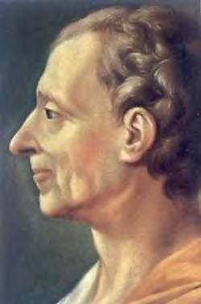
Montesquieu
“Power… should be a check to power.” AKA Checks and Balances
Key issue- Political Liberty
Believed that England’s government was the best politically balanced of the time
Book: On the Spirit of the Law- Proposed that separation of powers would keep any one individual or group from gaining too much power

Slide 8
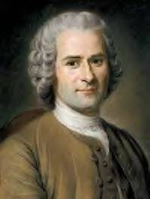
Rousseau
“Man is born free, and everywhere he is in chains.”
Key issue: Individual freedoms
Disagreed with Enlightened thinkers- argued that civilization corrupted men
Book: The Social Contract Government is an agreement among free individuals to create a society and a government
Best government= Direct Democracy with all people equal and no titles of nobility

Slide 9
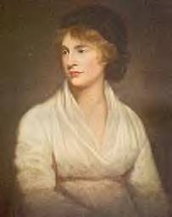
Mary Wollstonecraft
Feminist of the Enlightenment
Essay: A Vindication in the Rights of Women
Women need education to become virtuous and useful
Urged women to enter fields of medicine and politics
* Most Enlightenment writers did not focus on the rights of women

Slide 10
Political Consequences
More democratic styles of government
Enlightened Despots- monarchs who embraced the ideas of the Enlightenment and made reforms to reflect them
Changes in some nations
Frederick the Great of Prussia- reformed justice system, religious freedoms, improvements of education system, eliminated capital punishment
Old idea- the state and its citizens exist to serve the monarch… Louis XIV “I am the state”
New idea- the monarch exists to serve the state and support the citizens….Frederick the Great of Prussia, “the first servant of the state”

Slide 11
Social Consequences
Rise of a more secular outlook
Promoted the importance of individuals
Urged an end to the practice of slavery
Argued for greater social equality
Called for the end of superstition and fear and religion
Promote tolerance of all religions
Art was baroque (ornate design) replaced with neo-classical (simple and elegant)
Music-classical music (Bach, Beethoven, etc.)

Slide 13
Warm Up March 29
Who was the English philosopher who proposed that a government’s power comes from the consent of the citizens and that citizens have the right to rebel against unjust rulers
John Locke
Thomas Hobbs
Voltaire
Baron Montesquieu

