Slide 1
Revolutions in the New world

Slide 2
Warm Up March 30
The first constitutional monarchy in England included Parliament and which leaders?
William and Mary
Charles II
James I
Catherine and Henry

Slide 3
Glorious Revolution
In 16th & 17th centuries most countries were ruled by absolute monarchs
Divine right of Kings: Kings not accountable to citizens only to God
In England Monarchs realized having the support of Parliament was good

Slide 4
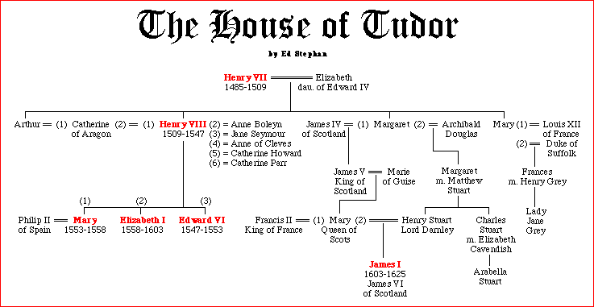

Slide 6
Background
King Henry VIII and Queen Elizabeth regularly consulted Parliament
King James I tries to re-establish an absolute Monarchy
Reign was referred to as the Eleven Years of Tyranny - 1629-1640
1642 Civil War broke out

Slide 7
English Civil War
Charles I tries to get Scottish to follow Anglican Prayer Book
Scots get mad, form an army, threaten to invade England
Charles needs money to fight the Scots
He can only get money by calling Parliament
Parliament hasn’t been called for 11 years

Slide 8
The Long Parliament
Parliament meets from 1640-1653
Parliament tries to pass laws limiting the power of the King
This makes Charles mad
He tries to arrest several leaders of Parliament, but they escaped
People of London get angry
Charles flees to Northern England to raise an army

Slide 9
English Civil War
2 sides
Cavaliers - were loyal to the King
Wealthy nobles, Flashy, long haired
Roundheads - Led by Oliver Cromwell
Were Puritan supporters of Parliament
Working class, middle class and Puritans
No side wins for first few years of war

Slide 10
Oliver Cromwell and the New Model Army
Parliament forms a professional group of soldiers in February of 1645
Very well disciplined
Promotions based on merit, not class
Most members had strong Puritan values
No drinking, cussing, women, gambling, etc.
Cavaliers eventually beaten by New Model Army

Slide 11
Civil War
Oliver Cromwell and the Roundheads win the war
Parliament tries King Charles I for being a tyrant, traitor, murderer, and public enemy.”
Was beheaded in January of 1649
Sent shock waves throughout Europe
If a monarch in England can be killed, a monarch can be killed in any country.
Cromwell set up a dictatorship and rules until his death in 1658
Parliament restores Monarchy after his death

Slide 12
Glorious Revolution
1685 James II becomes King (Catholic)
Names Catholics to High positions in the Government
Parliament invites Dutch leader William of Orange to invade England
James flees and William & Mary begin to rule England. – Constitutional Monarchy

Slide 13
Bill of Rights
William and Mary must agree to recognize Parliament and its rights
Can only raise an Army with parliaments consent
Citizens have the right to bear arms
Trial by Jury (Habeas Corpus)

Slide 14
Britain and Its Colonies
During the 1600s and the 1700s Great Britain had formed a profitable colonial organization along the eastern coast of the modern-day United States.
The colonies felt that they were independent.
England insisted on taxing the colonies and trying to control them.
This led to call for colonial independence and a revolt.

Slide 15
The Influence of the Enlightenment
Leaders in the English Colonies used the ideas of Enlightenment Thinkers to justify their call for independence.
EXAMPLE:
Voltaire – Free Speech, Religious Toleration
US Constitution – Bill of Rights
EXAMPLE:
Locke – Power of the gov’t comes from the people
US Constitution – “We the people of the United States…”
EXAMPLE:
Montesquieu – Separation of powers of gov’t
US Constitution – Establishes executive, legislative, and judicial branches of the gov’t

Slide 16
American Revolution’s Influence Abroad
The country that was most influenced by the revolution was FRANCE.
Copies of the Declaration of Independence circulated all over France
They looked at the American Revolution as a fulfillment of the Enlightenment thinker’s ideas.
“We talked nothing but of America”
The French people wanted to change the gov’t that they felt was so unjust.

Slide 17
Independence for Latin Americans
Problem: Spanish Colonial Class Structure
Peninsulares= those born in Spain (could hold high offices in government)
Creoles- Spaniards born in the new world (could not hold high levels in gov’t but could serve in the army)---- many were educated
Mulattos- people of mixed European & African
Indians- bottom
*** Peninsulares and Creoles held all power

Slide 18
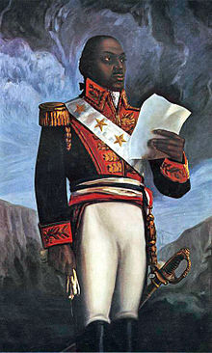
Haiti
French Colony- home to 500,000 slaves
100,000 enslaved Africans revolted
Leader- Toussaint
Agreement- end slavery = end to revolt
French sent him to prison anyway
Dessalines- led a 2nd revolt
Haiti - 1st black colony to become free of European rule

Slide 19
Latin American Independence
Fueled by Napoleon’s invasion of Spain
Led by wealthy, educated Creoles
Military leaders = Bolivar and San Martin- joined forces to win independence in Venezuela, Peru, Panama and Ecuador
MEXICO - Indians and Mesitzos led the fight and later joined with neighboring Creoles

