Slide 1
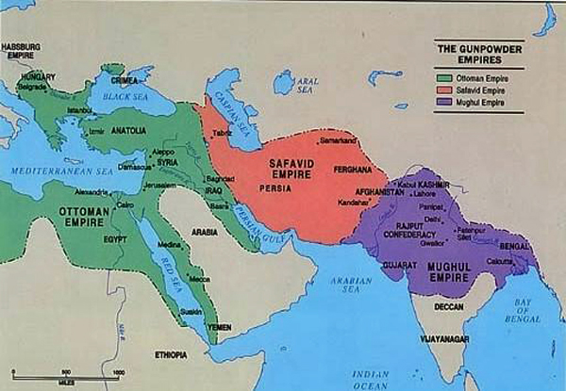
Ottoman, Safavid, & Mughal Empires

Slide 2
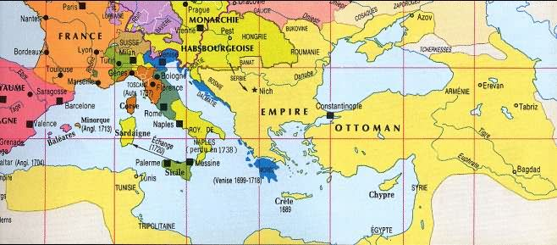
The Ottoman Empire
The Ottoman Empire = Turks
Mehmet II leads the siege of Constantinople to end the Byzantine Empire and Rise of the Ottoman Empire

Slide 3
The Ottoman Empire
Constantinople is rebuilt and renamed Istanbul
Ottoman Empire was ruled by Sultans – Supreme authority both politically and militarily
Hereditary position
1514 Sultan Seliem I took control of Arabia and declared himself the new Caliph
Caliph – defender of Islam and successor to Muhammad

Slide 4
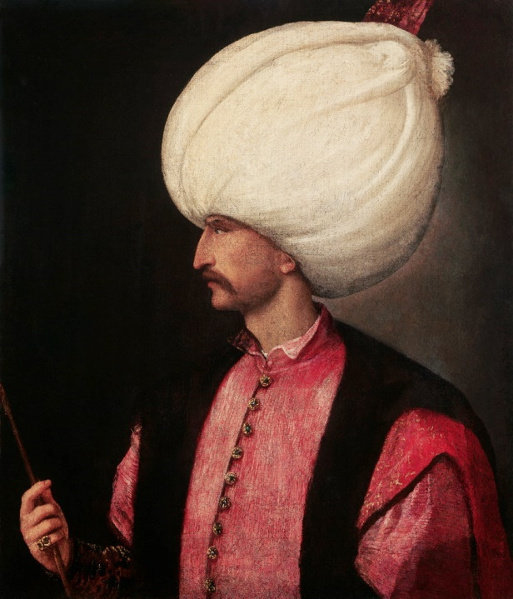
The Ottoman Empire
Suleiman I – Most famous Ottoman Ruler (1520 – 1566)
Helped the empire spread into Europe, controlling most of Eastern Europe
His reign is considered the height of the Ottoman Empire
After his death Sultans began to lose power

Slide 5
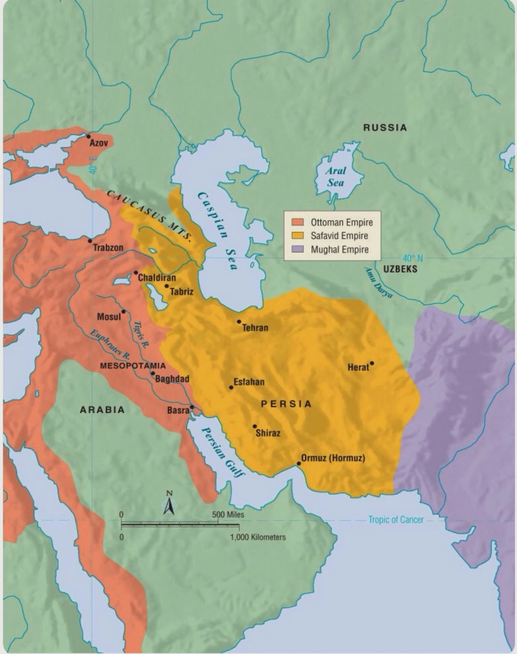
The Safavid Empire
Offset of the Persian Empire
Shiite Muslims
Constant Struggle with the Ottomans, who were Sunni
Founded by Shah Ishmail – declared himself Shah, or King, of a new Persian State
Claimed to be the spiritual leader of Islam

Slide 6
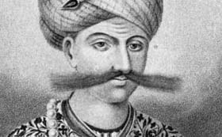
The Safavid Empire
Shah Abbas (1588 – 1629) ruled during the high point of the Safavid’s glory
Fought against the Ottoman’s to regain lost territory

Slide 7
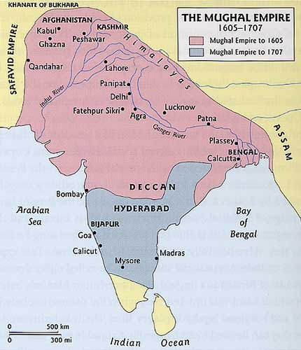
The Mughal Empire
Founded by Babur
Was a descendant of Genghis Khan
Was able to capture Delhi and establish his power in northern India
Used the most advanced military technologies

Slide 8
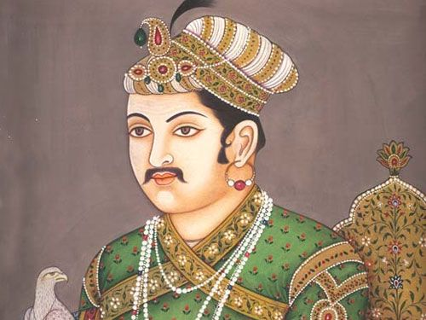
The Mughal Empire
Akbar, Babur’s grandson, takes control at the age of 14
Unfied most of India under one rule
Created a truly religiously tolerant state.
Most prosperous era of the Mughal Empire
The decline of the Mughals was hastened by the arrival of the British

