Slide 1
Imperialism

Slide 2
What is Imperialism
Imperialism - The policy of extending a nation's authority by territorial acquisition or by the establishment of economic and political hegemony over other nations in order to become a world power

Slide 3
Why did it happen
White Man’s Burden – Moral Responsibility to help primitive people
Spread Christianity
Need/want for resources like rubber, sugar, oil, tin, etc.
Increase national power—naval, etc. (belief that a strong navy=power)
European nations involved in rivalries — tried to get the “upper hand”

Slide 4
Direct vs Indirect Rule
Direct Rule – a colony would be governed by foreign officials while no self-rule was given to natives. The goal was assimilation of the colony into an empire. Government institutions were based on European governments. The Belgian King Leopold II practiced the most brutal style of direct rule in the Belgian Congo. Almost 10,000,000 Congolese were killed in his entire rule. France also often practiced direct rule of her colonies. Vietnam, Algeria, Morocco, and Tunisia are notable examples.

Slide 5
Direct vs Indirect Rule
Indirect Rule – a colony, local government officials might be used, while the native upper-class was given limited self-rule over the colony. The goal was to Westernize future leaders of a colony in order to perpetuate a power’s control. This was accomplished in Raj India under the British East India Tea Company until the Sepoy Rebellion. After the rebellion was put down, the British Government assumed direct rule over the colony.

Slide 6
Berlin Conference
Goals of Berlin Conference:
Take Africa’s land
Christianize and Civilize Africa
Divide up Africa’s land between Europe
Words to describe European actions?

Slide 7
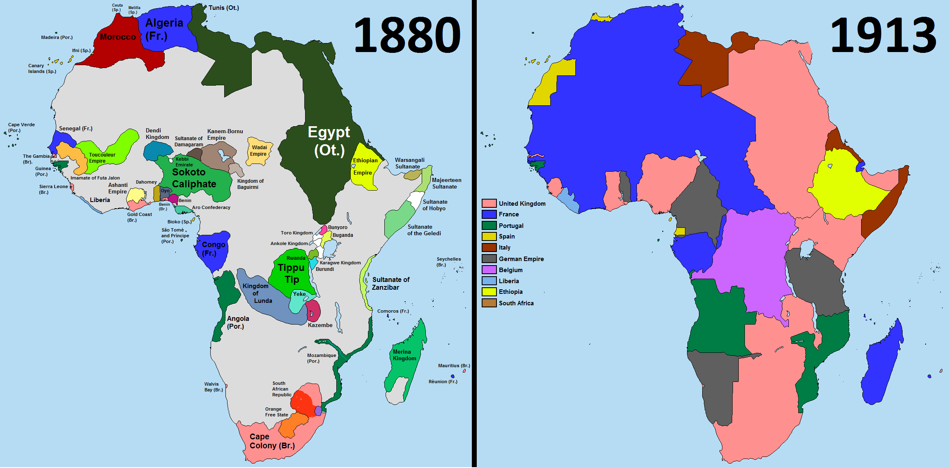

Slide 8
Imperialism in Asia
Tai Ping Rebellion
Led by Hong Xiuquan
Called for Social Reforms – Equality
Lasted for 10 years and eventually fell apart when Europeans came to the aid of the Qing

Slide 9
Imperialism In Asia
For year the British exported way more than they imported to China
Britain began importing Opium from India.
Chinese ask them to stop poisoning their people.
Opium War was fought and the British easily defeated the Chinese.

Slide 10
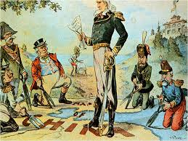
Imperialism in Asia
Opening the Door to China
US proposed a deal that would allow access to all Chinese markets – Open Door Policy

Slide 11
Imperialism in Asia
The Boxer Rebellion
Boxer was a popular name given to members of a secret organization known as the Society of Harmonious Fist
“Destroy the Foreigner”
Disliked Christian missionaries and converts
Roamed the Countryside slaughtering Christians
Allied Army came to china and invaded Beijing restoring order and demanding consequences

Slide 12
Commodore Perry
Brought a letter form President Fillmore requesting to open foreign relations between America and Japan.
Japan eventually agreed under military pressure
This opened two ports between the US and Japan

