Slide 1
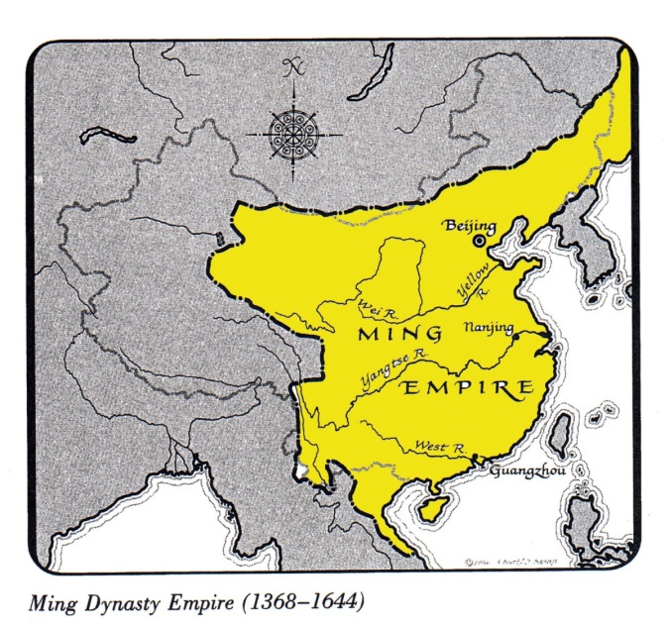
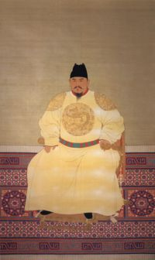
China: Ming Dynasty
Ming Dynasty: dominant power in Asia from 1368-1644
Hong Wu: commanded a rebel army that drove out the Mongols in 1368 and became the 1st Ming Emperor
Promoted reforms to restore agricultural lands destroyed by war, erase all trace of Mongols, & promote China’s power and prosperity

Slide 2
China: Ming Dynasty
China’s trade policies reflected isolation
Only government officials were allowed to conduct foreign trade through 3 coastal ports
However, smuggling went on up and down the ports

Slide 3
Ming Dynasty
The Voyages of Zheng He were during the Ming Dynasty
In 1514 a Portuguese fleet arrived in China
1st contact with Europeans since Marco Polo, almost 200 years
Chinese were not impressed with the Portuguese and the Western Ideas
Jesuits came with Merchants to attempt to spread Christianity

Slide 4
Fall of the Ming Dynasty
Decline begins with a series of weak rulers during the late 16th century
This led to a peasant revolt which overthrew gov’t and a new dynasty was created, the Qing (Ching)

Slide 5
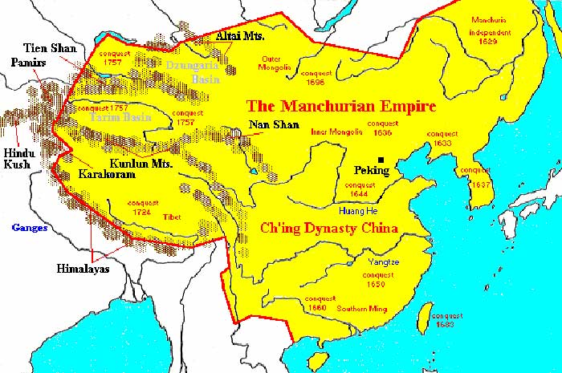
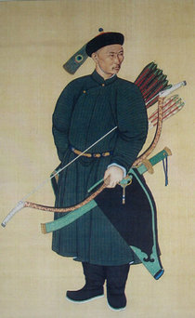
China: Qing Dynasty
Manchus: people of Manchuria (west of the Great Wall) invaded China and took over the Ming (had ruled for 200 yrs)
Qing Dynasty: name taken of the Manchus as they ruled for 260 yrs
Expanded China’s borders to include Taiwan, Chinese central Asia, Mongolia, and Tibet

Slide 6
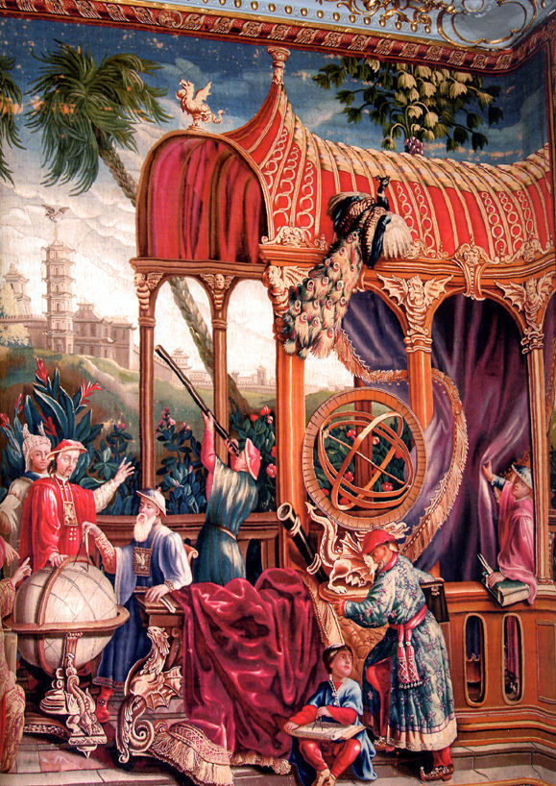
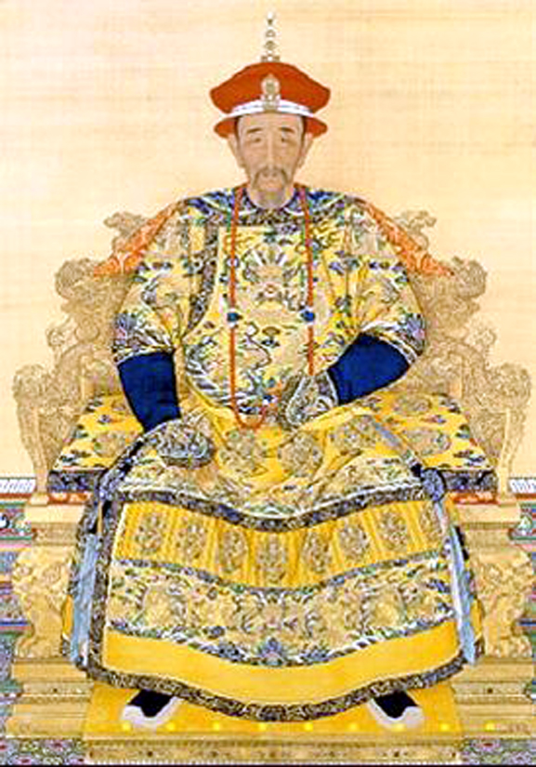
China: Qing Dynasty
Rulers
Kangxi: Qing Emperor 1661-1722
Reduced govt.
expenses
Lowered taxes
Patron of the arts
Welcomed the Jesuits who told them of science, medicine, mathematics, etc. in Europe

Slide 7
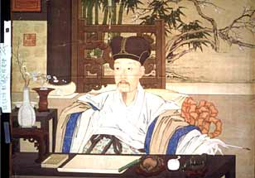
China: Qing Dynasty
Qian-long:
Kangxi grandson
China reached its greatest size and prosperity

Slide 8
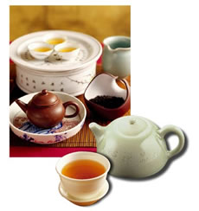
China: Qing Dynasty
Chinese continue isolation
China, center of universe
If foreigners wanted to trade, they had to follow the Chinese rules
Special ports & tribute
Dutch followed the rules
Dutch returned w/ many
trade items including a new
one…TEA.
By 1800 tea made up 80% of shipments to Europe

Slide 9
China: Qing Dynasty
British also wanted to trade, but didn’t like the rules
1793 Lord Macartney of England delivered a letter from the king asking for better arrangements
Qian-long declined
This leads to problems later

Slide 10
Japan’s 3 Daimyo
Background
In the 1300s Japan had developed unity under the Shoguns (military rulers). In 1467, civil war shattered Japan’s feudal system and the country slipped into chaos as violent disorder followed. AKA-”Warring States” period. Eventually powerful samurais gained control and offered protection to peasants in return for loyalty. Their new system of feudalism resembled that in Europe, with castles, small armies, and now, muskets.

Slide 11
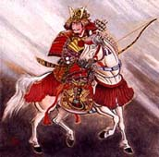
Japan’s 3 Daimyo
Daimyo: warrior chieftains who become lords in Japan
Oda Nobunaga: brutal and ambitious daimyo who hoped to gain enough power to take the whole country.
Seized the capital in 1568
“rule the empire by force”
1st to use muskets in Japanese battle
1582 committed seppuku (ritual of
suicide of a samurai) when one of his
own generals turned on him

Slide 12
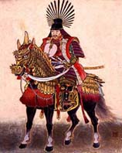
Japan’s 3 Daimyo
Toyotomi Hideyoshi: Nobunaga’s best general, continued his mission of destroying the daimyo that remained hostile
By 1590 he controlled most of Japan
Wanted to conquer China, so sent troops to Korea (allies with Ming)
Hideyoshi died 1598, troops w/drew from Korea

Slide 13
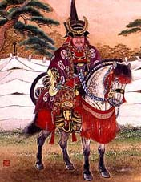
Japan’s 3 Daimyo
Tokugawa Ieyasu: completed the unification of Japan
1600, defeated rivals
Became sole ruler of Japan
Tamed the daimyo at the local level by requiring them to spend every other year in the capital
Founded Tokugawa Shogunate: dynasty of shoguns that ruled Japan until 1876

Slide 14
Life in Japan
Contact between Japan and Europe
Europeans began coming to Japan in the 16th century and were welcomed
Shipwrecked Portuguese washed up on their shores
Brought clocks, eyeglasses, tobacco, firearms, & other unfamiliar items
Daimyo very interested in firearms (traditional weapon was sword). They wanted every advantage over others
Many samurai kept the traditional sword and lost badly in battle

Slide 15
Japan’s Closed Country Policy
At first, Japan welcomed new trade
Over time, they realized they could safely exclude both missionaries and merchants
1639 they sealed their borders and instituted their “Closed Country Policy”
Only ONE port, Nagasaki, remained open to Chinese and Dutch.

