Slide 1
An Age of Exploration 1400-1800

Slide 2
Warm Up March 16
What was the journey across the Atlantic Ocean known as during the slave trade?
Atlantic Slave Trade
Middle Passage
Triangular Trade
Middle Way

Slide 3
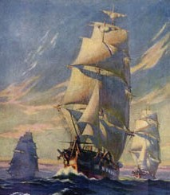
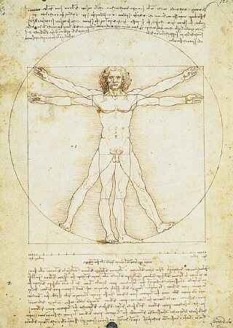
Background
By 1400, Europeans were ready to venture beyond their borders
Renaissance encouraged a new
spirit of adventure and curiosity
Printing press spread ideas and
new maps and charts
Crusades brought new inventions

Slide 4
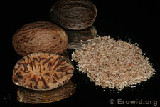
Causes of European Exploration
#1- New Trade Routes
People want wealth; achieve that through trade
Traded spices (nutmeg, ginger, cinnamon, pepper)
Introduced during Crusades; people still demanded goods once wars ended
Demand greater than supply = high prices

Slide 5
Causes of European Exploration
Trade routes controlled by Italians and Muslims
Muslims sold Asian goods to Italians
Italian merchants resold items at increased prices to merchants throughout Europe
Other traders did NOT like this and wanted new routes that bypassed Italian merchants

Slide 6
Causes of European Exploration
#2- Spread Christianity
Crusades left hostility between Christians and Muslims
Europeans believed they had a sacred duty to continue fighting Muslims
and to convert non-Christians

Slide 7
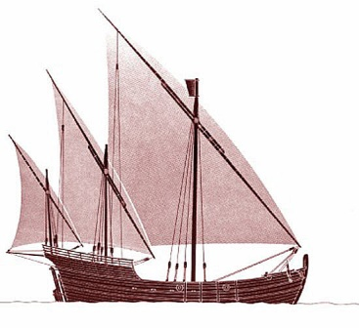
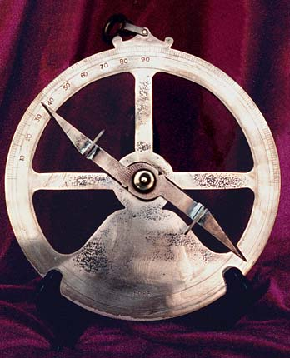
Causes of European Exploration
#3- New Exploration Technologies
Caravel: stronger, sturdier ship (adopted from Arabs); made it possible to sail against the wind
Astrolabe: used to calculate latitude
(perfected by Muslims)
Compass: magnetically tracked
direction (Chinese invention)

Slide 8
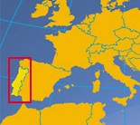
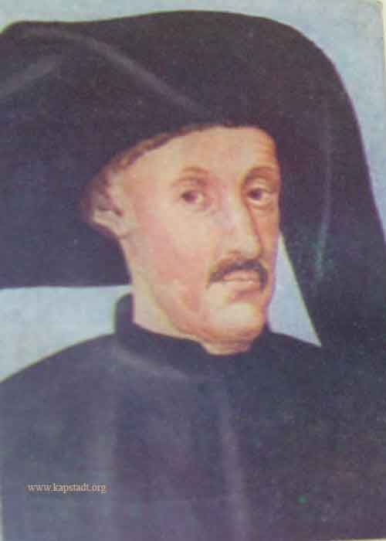
Portugal leads the way
Portugal was 1st to establish trading outposts along the west coast of Africa
Prince Henry: creates school of Navigation
mapmakers, shipbuilders, scientists, and sea captains, gathered there to perfect their trade
Nation’s most enthusiastic supporter of exploration
Conquered Muslim city in North Africa where he discovered exotic wealth never found in Europe (cinnamon, cloves, pepper, silver, gold, jewels.

Slide 9
Portugal leads the way
By Henry’s death, Portugal held a series of trading posts along western African shores.
Traded for gold and ivory
Eventually, they traded for African captives (slaves)
Next, Portugal searched for a trade route to Asia

Slide 10
Warm Up March 17
The global transfer of foods, plants, and animals during the colonization of the Americas is known as
Columbian Exchange
Joint-stock company
Mercantilism
Capitalism

Slide 11
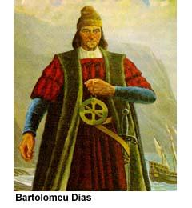
The Cape of Good Hope
Bartolomeu Dias - First person to sail around the southern tip of Africa
1488 Sailed down w. coast of Africa where he reached the tip Huge storm arose, battered ships Realized his ships were blown around the tip Explored SE coast but crew was exhausted so they returned home
”To serve God and His majesty, to give light to those who were in darkness and to grow rich as all men desire to do.”

Slide 12
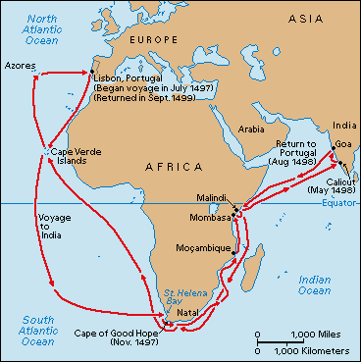
Portugal leads the way
Vasco da Gama
1498 began exploring east African coast
Reached Calicut (SW coast of India)
Amazed by spices, rare silks, precious gems
Filled boats with goods and returned to Portugal where they sold them for 60 times the cost of the voyage
Vasco da Gama’s - first to sail around Africa to India

Slide 13
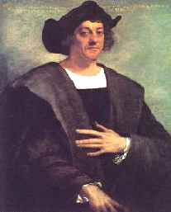
Spain also makes claim
Christopher Columbus
1492 he convinced Spain to pay for his plan to find a trade route to Asia by sailing west across the Atlantic Ocean

Slide 14
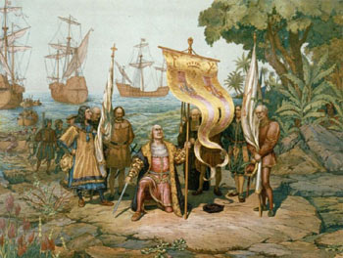
Spain also makes claim
October 1492: landed on a Caribbean Island which he mistook for the East Indies (AKA -Indonesia.)
Immediate impact of Columbus: Increased tension between Spain and Portugal.

Slide 15
The Columbian Exchange
The Columbian Exchange – The Global Transfer of foods, plants, and animals during the colonization of the Americas.
Note: This includes North, Central, and South America
Its called the “Columbian” exchange because of Christopher Columbus’ initial contact with the Americas

Slide 16
The Columbian Exchange
Items coming to Europe, Asia, Africa from the New World
Plants
Tomatoes, squash, pineapples, tobacco, and cacao beans (chocolate)
Animal
Turkey
Most important
Corn and potatoes
“The planting of the first potato in Ireland, and the first sweet potatoes in China probably changed more lives than the deeds of 100 kings.”

Slide 17
The Columbian Exchange
Items coming to the New World from Europe, Asia, Africa
Livestock
Horses, sheep, cattle, and pigs
Foods
Bananas, black-eyed peas, yams, wheat, rice, barley, and oats
Disease
Small pox, measles, malaria, and Whooping Cough

Slide 18
Results of The Columbian Exchange
Positive
Both areas benefited from the introduction of new items
Economies in both areas were boosted
Negative
Native Americans suffered due to the diseases and weak immune system
Slave trade flourished due to the agricultural opportunities in the New World

Slide 19
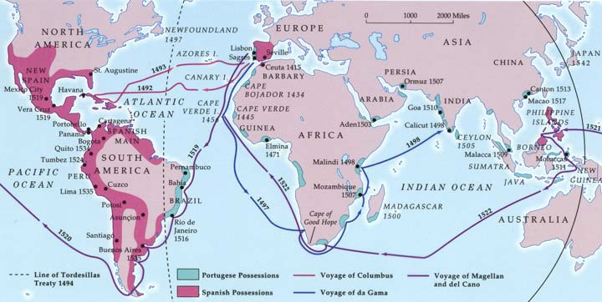
Early Explorers
Ferdinand Magellan – First person to Circumnavigate the globe
James Cook – Sailed from England, first to sail to the Arctic and Antarctica

Slide 20
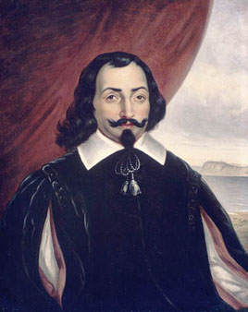
Early Explorers
Samuel de Champlain – founded Quebec in 1608, gave France a claim to the New World

Slide 21
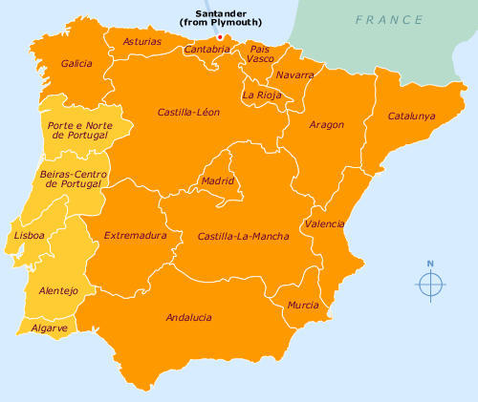
Spain also makes claim
Spain vs. Portugal
Portugal believed Spain reached Asia and that Columbus claimed lands that the Portuguese might have reached first.
Pope Alexander VI divided the land between the 2 nations

Slide 22
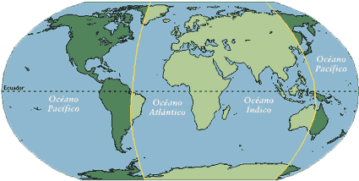
Spain also makes claim
He drew the Line of Demarcation: imaginary North/South line that gave lands on the east to Portugal (light green) and the lands on the west to Spain
1494 Spain and Portugal signed the Treaty of Tordesillas: they agreed to honor the line.

Slide 23
China’s Exploration
Hongwu eventually dies, his son (Yonglo) takes over. He was very curious of the world so he launched 7 voyages of exploration.
Zheng He led all 7 voyages for the Ming Dynasty
40 to 300 ships made the voyages: fighting ships, storage vessels, and “treasure” ships (400 ft long!)
Carried soldiers, sailors, interpreters, accountants, doctors, and religious leaders.

Slide 24
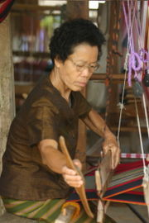
China’s Exploration
Zheng He showed superiority by leaving silver and silk as gifts
More than 16 countries paid tribute to China
Officials complained it was a waste and the voyages ceased after the 7th in 1433

Slide 25
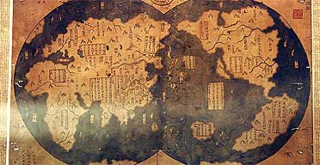
Zheng He Map - 1418

Slide 26
Warm Up March 18
Who was the first person, credited by historians, to circumnavigate the world?
Vasco da Gama
Christopher Columbus
Ferdinand Magellan
James Cook

